Slide 1
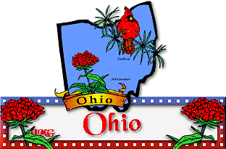
By Z Love

Slide 2
Ohio became a state on March 1, 1803. The state capital is Columbus. Population: 11,570,808 State song: Beautiful Ohio Nickname: The Buckeye State Motto: “With God, All Things Are Possible”

Slide 3
State Flower: Scarlet Carnation
Scarlet Carnations are the most fragrant of the carnation species. It has a spicy clove-like aroma. The flowers are 2-4 inches wide with five petals, which are grazed and serrated.

Slide 4
State Tree: Buckeye
A Buckeye tree is native of the Midwestern and Great Plains states. The tree can grow to reach 60 feet tall and be 30 feet wide. Its lightweight wood is used in the production of artificial limbs.

Slide 5
State Bird: Cardinal
State Bird: Cardinal
Male cardinals are bright red all over, with a reddish bill and black face immediately around the bill. Female cardinals are pale brown overall with reddish tinges in the wings, tail and crest. Cardinals do not migrate.

Slide 6
Ohio State Flag
This is the only American state flag that is not a rectangle. The 13 stars near the circle represent the original 13 states in the USA; the 4 extra stars near the peak of the triangle symbolize the fact that Ohio was the 17th state admitted to the union. The blue triangle represents Ohio’s hill country. The white “O”may stand for Ohio (but it is not certain).

Slide 7
USA Map showing Ohio

Slide 8
Natural Resource Map
Since the 1800’s, more than 3 billion tons of coal has been mined in Ohio.
In 2015, Ohio’s oil and gas industry drilled an estimated 460 oil and gas wells in 42 of Ohio’s 88 counties
In 2015, industrial minerals such as limestone, sand, gravel, and salt, were mined in 87 of Ohio’s counties.
In 2014, Ohio used about 8.6 billion gallons per day of water from surface and ground water sources.
Ohio harvests 300 to 400 million board feet of timber each year.

Slide 9
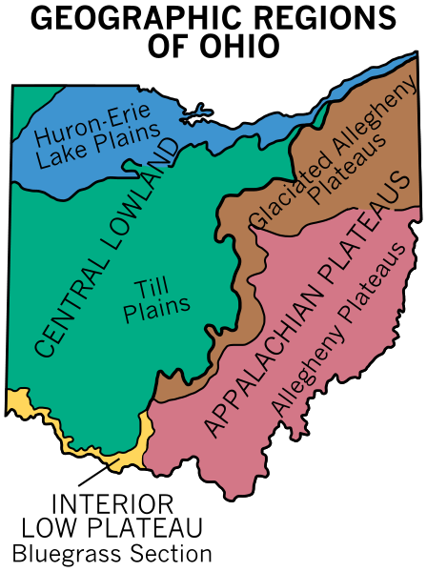
Ohio has many interesting geographic features. It consists of rolling plains for the most part. In the north, has over 300 miles of Lake Erie shoreline and thousands of miles of rivers. There are scattered sand dunes found across Lake Erie’s shoreline and clay bluffs along the eastern side of the lake. The Lake Erie Plains, part of the Great Lake Plains, extend southward from the lake into Ohio. The Allegheny Plateau is located in the east. The Till Plains cover the western portion of the state.

Slide 10
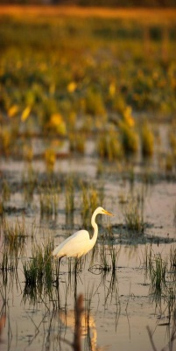
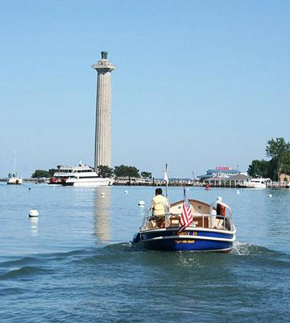
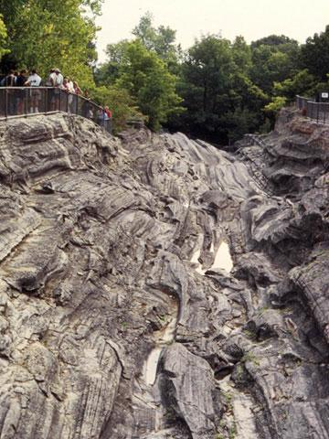
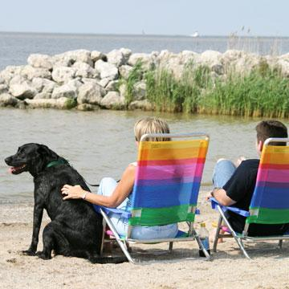
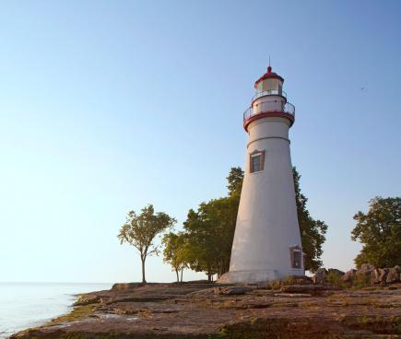
Lake Erie
With it’s 312 miles of shore line Lake Erie is a favorite destination. It has over 26 islands. The Ottawa National Wildlife Refuge area has one of the best bird-watching areas. In this area you may see a haven for blue herons, egrets and other fowls. You may even see deer, foxes, coyotes, and bald eagles. Lake Erie is also an ideal location for fishing bass, catfish, steelhead, and rainbow trout. Even in the winter you can go ice fishing. I would like to go to lake Erie because I really like fishing and I would like to try to ice fish.

Slide 11
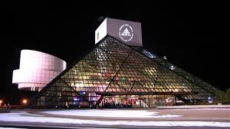
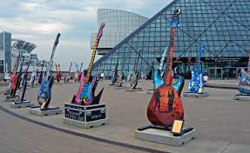
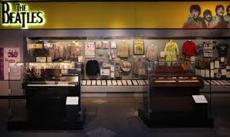
Rock and Roll Hall of Fame
The Rock and Roll Hall of Fame Foundation was built in 1983. It is located in downtown Cleveland Ohio. The museum and hall of fame celebrates the history and cultural significance of rock music and honors the people who have played an important role in music. The building has over 150,000 square feet of glass. I would like to go there to see Elvis Presley’s exhibit because he is my 11th cousin.

Slide 12
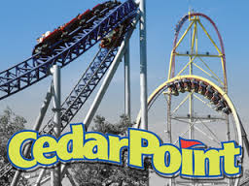
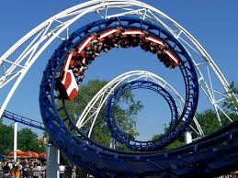
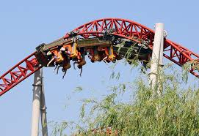
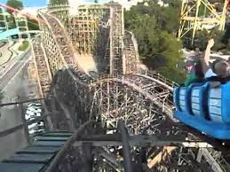
Cedar Point is 364 acre amusement park located on a Lake Erie peninsula in Sandusky, Ohio. Opened in 1870, it is the second-oldest operating amusement park in the United States. The park features a world record 71 rides and 16 roller coasters. Since I love roller coaster, I would definitely want to go here! For instance the one at Knott’s Berry Farm
X-celerator is my favorite roller coaster ever!

Slide 13
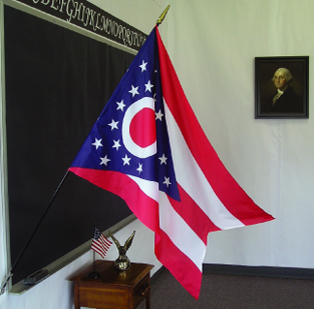
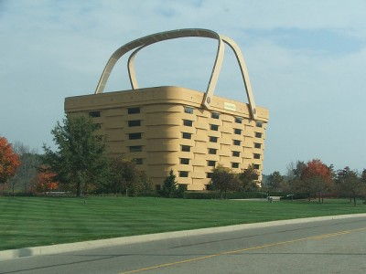
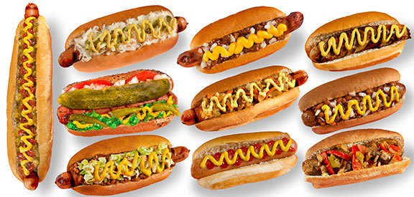
Fun Facts about Ohio
I love Ohio because there is a famous You Tuber called Roman Atwood vlogs. He is the greatest vloger of all time. Fun Fact Roman Atwood is the first vloger ever.
Neil Armstrong is the first man to walk on the moon.
Ohio gave America its first hot dog in 1900.
It is home of the worlds largest basket. It is located at Basket Village USA.
Ohio’s state flag is the only state flag that is not a rectangle.

Slide 14
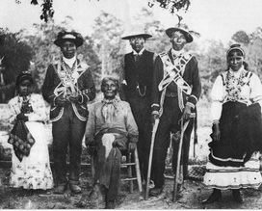
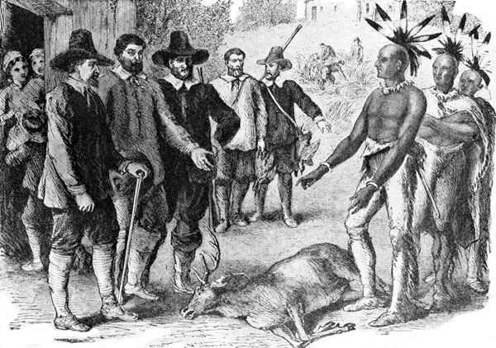
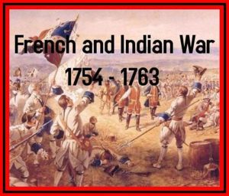
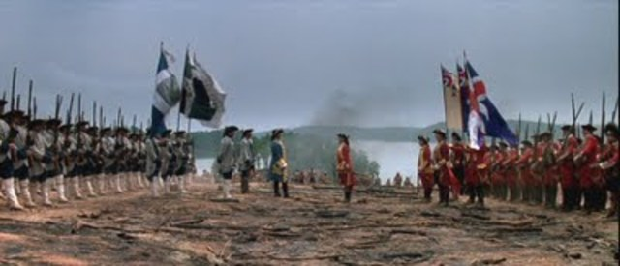
Early History
Native Americans
In the 1600s the Iroquois Indians moved into the land in order to hunt for beaver furs. Many of the existing tribes were pushed out of the region. However, due to diseases brought by Europeans, many of the Iroquois were wiped out.
Europeans Arrive
The first European to arrive in Ohio was French explorer Robert de La Salle in 1669. He claimed the land for the French. Soon the French had established trading posts in order to capitalize on the valuable fur trade in the region. They built several forts including Fort Miami in 1680 and Fort Sandusky in 1750. In the early 1700s, British colonists from the east coast began to move into the area. They were looking for new land to settle and wanted a part of the fur trade. Soon the British and the French were competing for the fur trade, which eventually led to war. French and Indian War The war between the French and British lasted from 1754 to 1763. It is called the French and Indian War. The Ohio region was the site of many battles and bloodshed. George Washington fought on the side of the British in Ohio at the Battle of Fort Necessity. The British eventually won the war and took over the Ohio region in 1763. Northwest Territory When the Revolutionary War ended in 1783, Ohio became part of the United States.

Slide 15
Important Events in Ohio’s History
In 1788, General Putnam led a number of settlers into Ohio and established Marietta as the first permanent settlement. Soon, many more settlers from the United States moved into the land. The population grew until, in 1803, Ohio was admitted into the union as the 17th state.
1813, the British were defeated in the war of Lake Erie. The Battle of Lake Erie, was fought on September 10, 1813, in Lake Erie off the coast of Ohio during the War of 1812. Nine vessels of the United States Navy defeated and captured six vessels of British Royal Navy. This ensured American control of the lake for the rest of the war. It was one of the biggest naval battles of the War of 1812.
1825 Construction on the Erie Canal begins and it was completed in 1832. The canal links the waters of Lake Erie in the west to the Hudson River in the east. An engineering marvel when it was built, some called it the Eighth Wonder of the World.
1861-1865 the Civil War was fought. Ohio fought for the Union. The Battle of Buffington Island is the only Civil War battle in Ohio. The battle contributed to the capture of the famed Confederate cavalry raider, Brig. Gen. John Hunt Morgan, who was seeking to escape Union army pursuers across the Ohio River at a ford opposite Buffington Island.
1868 U. S. Grant, from Point Pleasant, Ohio is elected the 18th president of the United States. He stabilized the nation during that turbulent period and enforced civil rights.
e

Slide 16
Famous people
Dav Pilkey Jr
Dav Pilkey was born in Cleveland, Ohio. In elementary school in Ohio, he was diagnosed with ADHD and dyslexia. Pilkey was frequently reprimanded for his behavior in class and thus usually sat at a desk in the school hallway, where he created the Captain Underpants character.
R.L Stine
Stine was born on October 8, 1943 in Columbus, Ohio. He grew up in Bexley, Ohio. He began writing at age nine, when he found a typewriter in his attic, subsequently beginning to type stories and joke books. He is one of America’s best selling authors of children’s books.

Slide 17
In my opinion, Ohio is the best state EVER because Roman Atwood lives there!!!
In conclusion what I thought was interesting about Ohio is:
It was the first place to give America hotdogs.
I learned that Roman Atwood was the first vloger ever.
I did not know that Ohio has such a fun amusement park. I would
love to go on the awesome roller coasters.
4. Last, I did not know that R.L Stine lives there.

Slide 18
Famous Buckeye Candy
Easy Buckeyes
Recipe type: Dessert
Prep time: 1 hour 20 mins
Total time: 1 hour 20 mins
Serves: 30-36
Ingredients
1½ cups peanut butter
1 cup butter, softened
½ teaspoon vanilla extract
6 cups confectioners' sugar
4 cups semisweet chocolate chips or chocolate candy coating
Instructions
Line a large tray or baking sheet with wax paper.
In a large bowl, combine the confectioners' sugar, peanut butter,vanilla extract and butter, stirring until well blended.
Roll the peanut butter mixture into 1-inch balls, and place the balls on a wax paper-lined baking sheet.
Press a toothpick into the top of each ball (to be used later as the handle for dipping) and chill in freezer until firm, about 30 minutes.
Melt chocolate chips in microwave (about 1 minute).
Using the toothpick as a handle, dip each peanut butter ball in chocolate.
Leave a small portion of peanut butter showing at the top to make them look like Buckeyes.
Place chocolate covered peanut butter balls on wax paper and remove the toothpick.
Once the peanut butter has softened, you can use a finger to smooth over the hole from the toothpick.
Refrigerate, until chocolate is set. Store in refrigerator until eating or gifting.

